Slide 1
Digital Storytelling
Jeffrey Roberts
Social Media Manager, ELCA

Slide 2
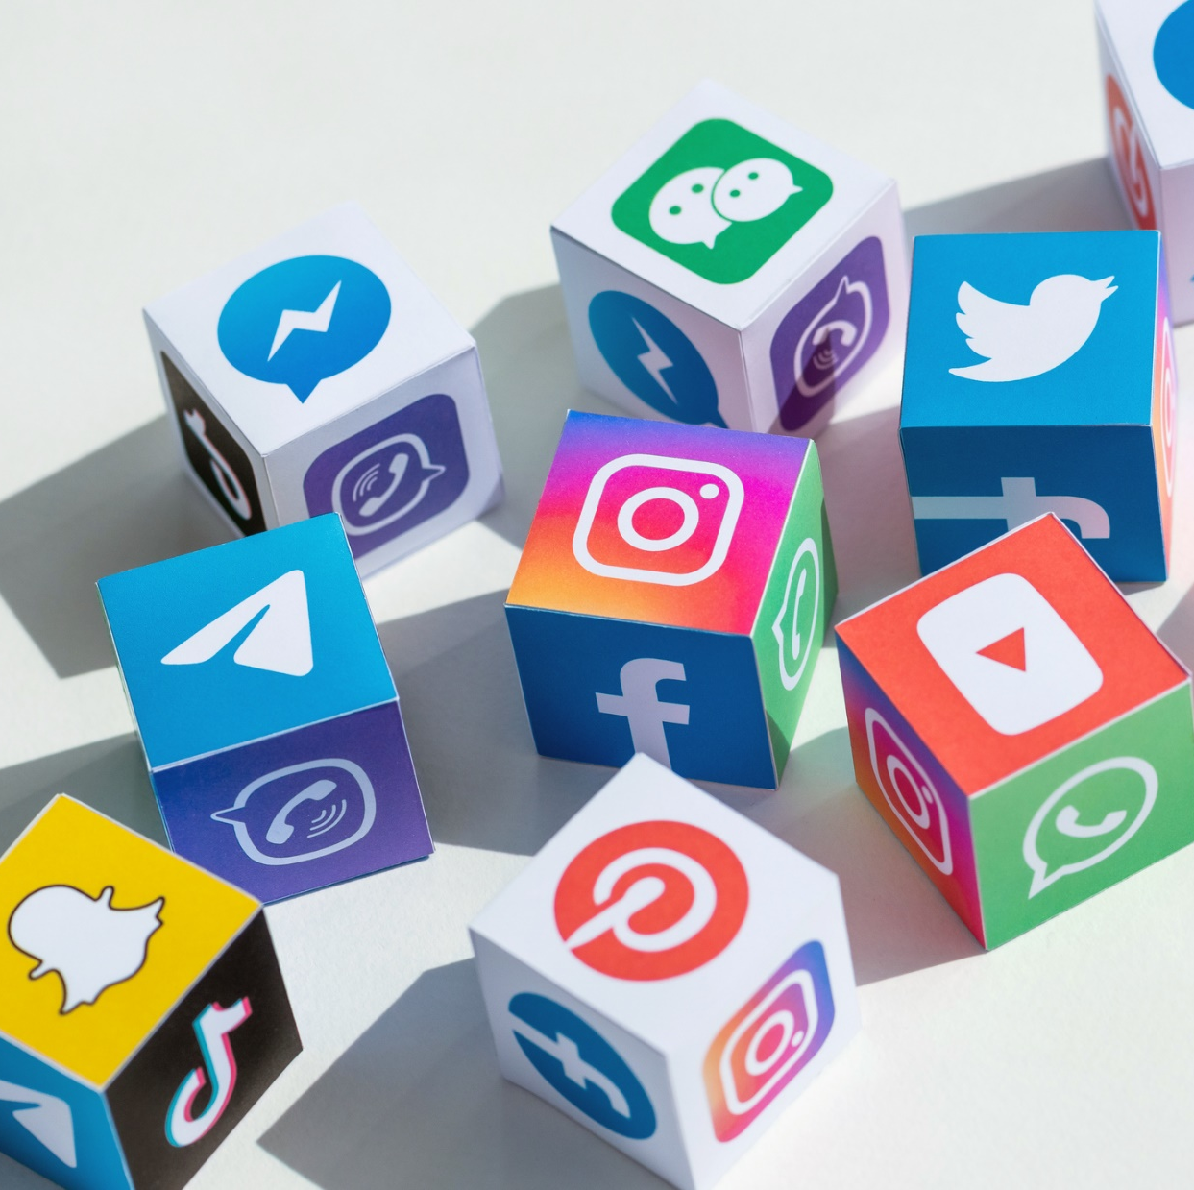
Taking Inventory
Evaluate your goals and capacity
Identify what communication channels your congregation already uses
Social media
Blogs
Website
Email

Slide 3
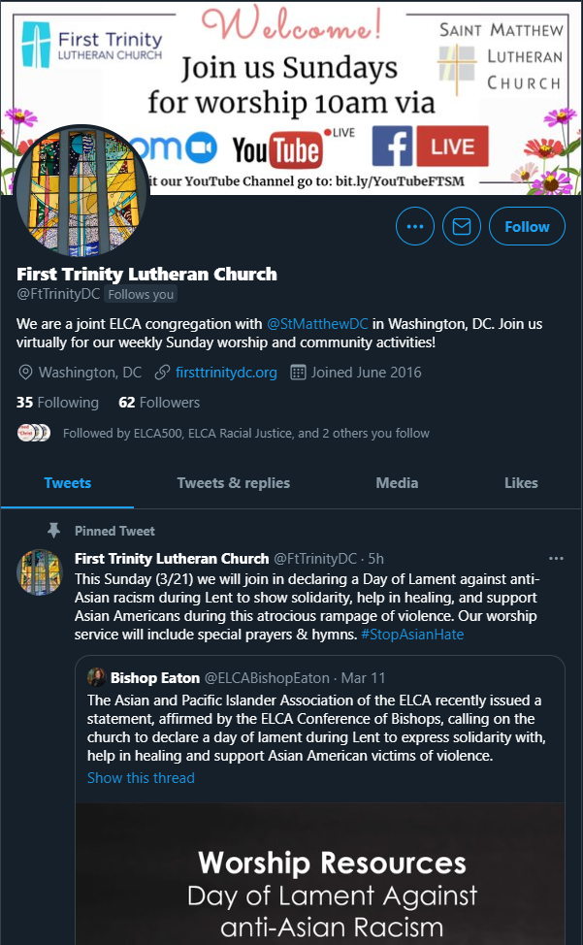
Benefits of a Twitter account
Short messages with 280 characters and the option to link to more
It’s often the place people engage at events as people “congregate” around a hashtag
It’s a quick way to respond and be a timely voice in online conversation

Slide 4
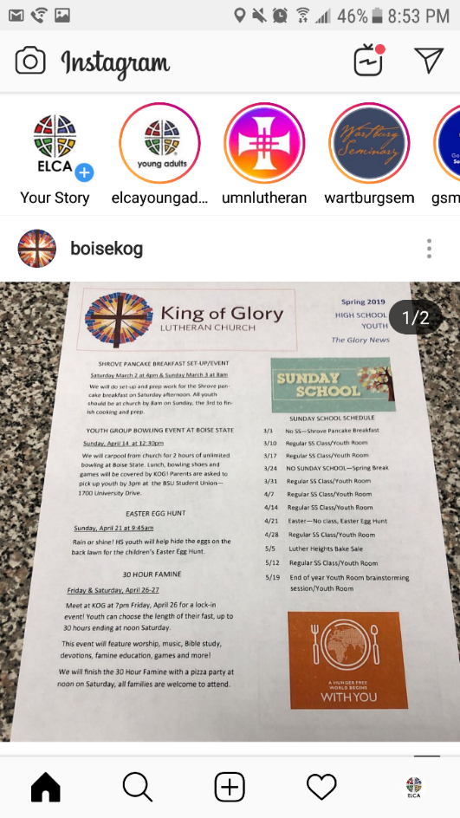
Benefits of an Instagram account
Visual storytelling through photos and video
Stories
Feed
Fastest growing social media platform
Exclusively mobile, not desktop-based

Slide 5
Benefits of a Facebook page
Schedule posts ahead of time and see page insights
Multiple people can be page administrators
Consider adding at least one other staff member as backup
It doesn’t mean that other people will post regularly, but they are available to assist as needed.
Receive messages through a Facebook inbox

Slide 6
Where to find
and create content

Slide 7
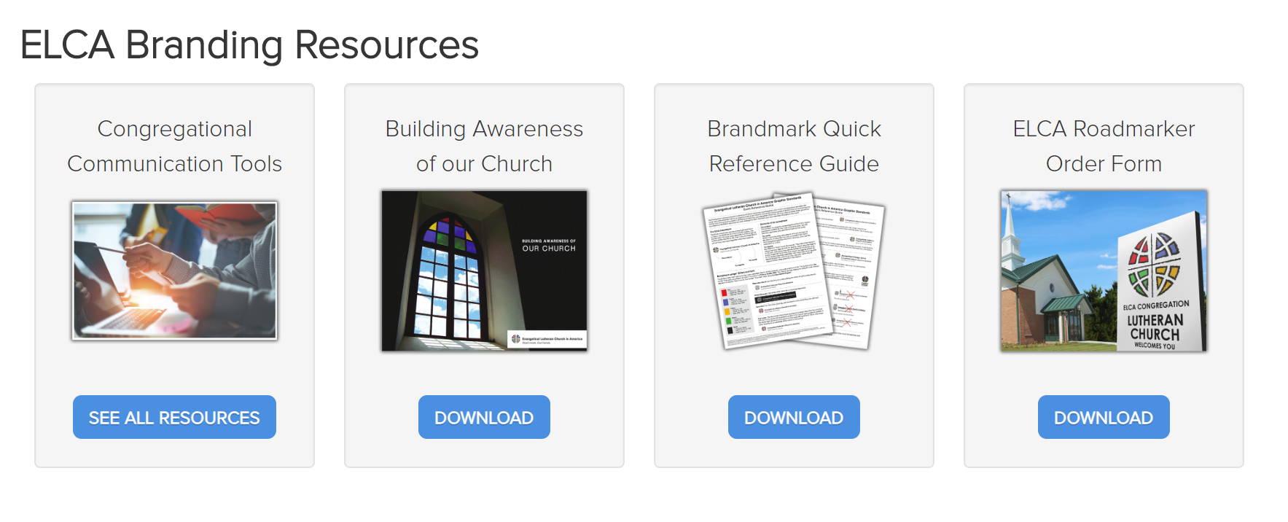
ELCA.org/CongTools

Slide 8
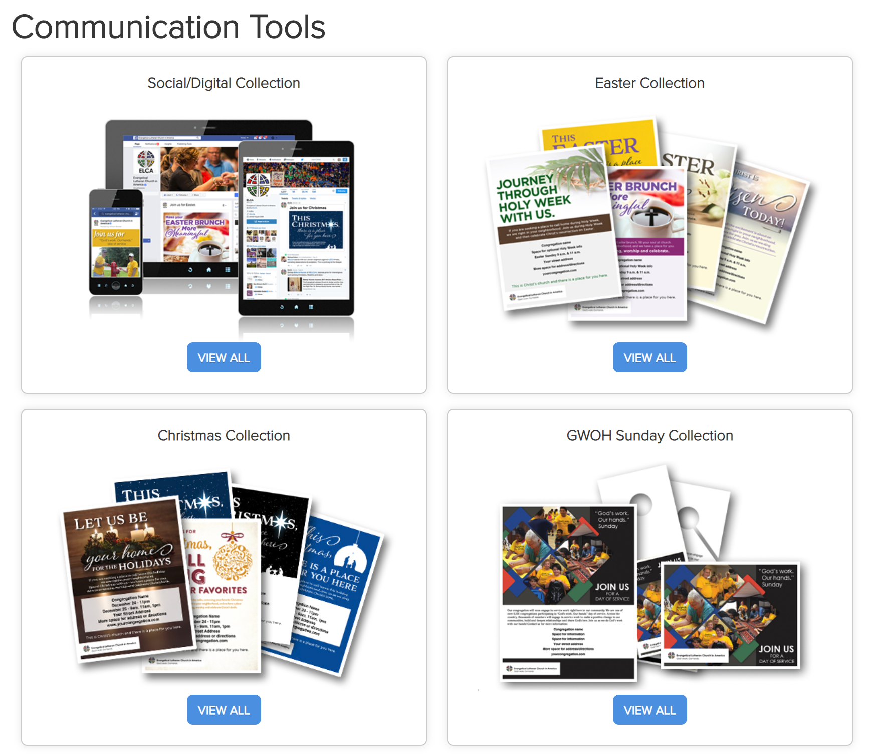
ELCA.org/CongTools
Notes:
https://elca.org/Resources/Congregational-Communications-Tools#SocialDigital

Slide 10
Notes:
https://elca.org/Resources/Congregational-Communications-Tools#Christmas

Slide 11
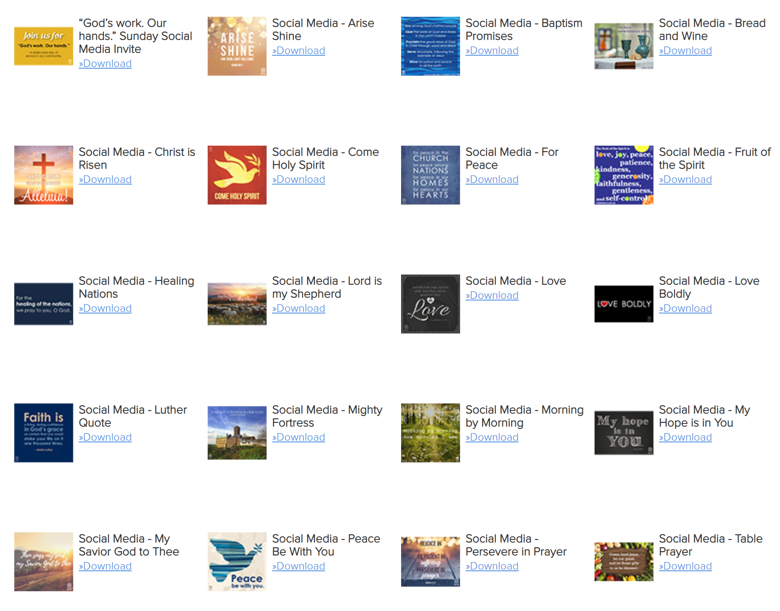
Social Media Graphics
Notes:
https://elca.org/Resources/Congregational-Communications-Tools#SocialDigital

Slide 14
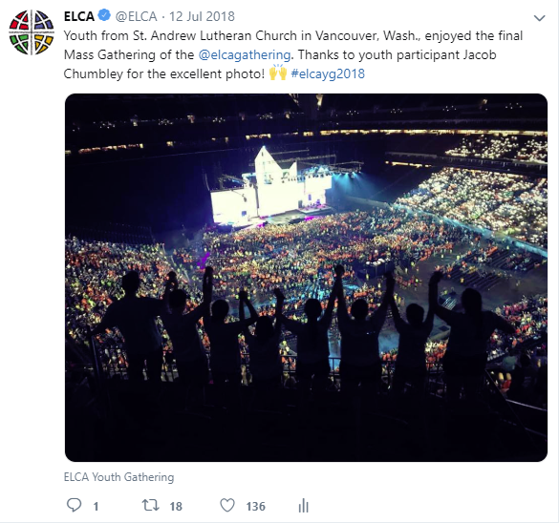

Slide 15
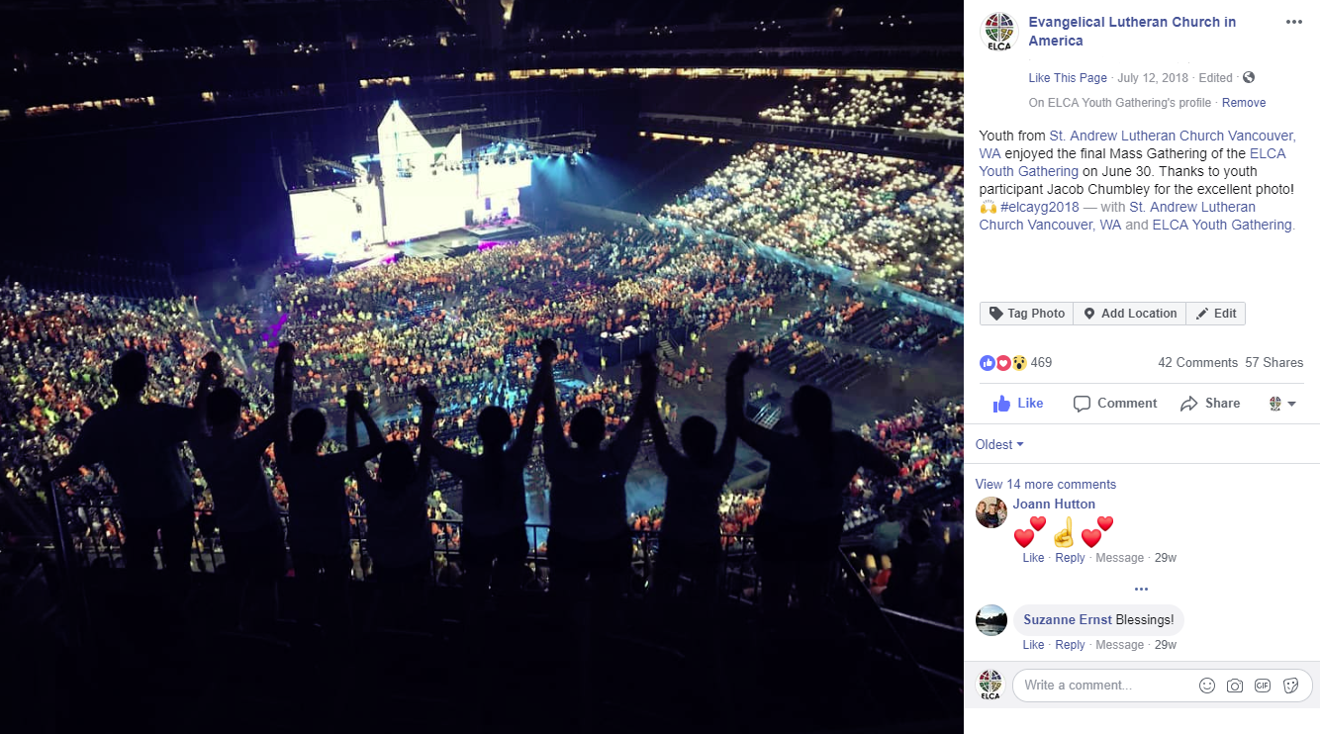

Slide 16
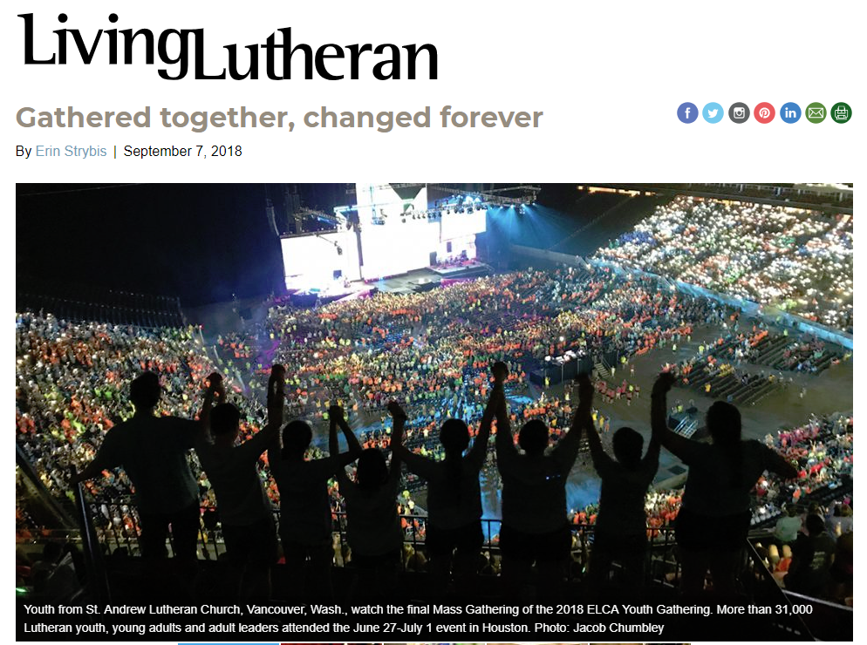
Notes:
Living Lutheran used it as their hero image for the Youth Gathering feature article.

Slide 17
Notes:
And it even made it into print! There was a time when cell phone images would not have been hi-resolution enough to print in the magazine, but now the cameras are powerful enough to provide a large photo in print without looking pixelated.
One note about photos – don’t steal them. Ask for permission, ask if anyone needs a photo credit. If you would like to use a picture by a professional photographer, they may ask for compensation, so you might expect to have that conversation.

Slide 18
Questions? Jeffrey.Roberts@elca.org

Slide 19
Thank you!

